Slide 1
Module 1
Introduction to XML

Slide 2


Module Overview
In this module, you will learn about:
Introduction to XML
Exploring XML
Working with XML
XML Syntax

Slide 3

Features of Markup Languages 1-2
Generalized Markup Language (GML) helps the documents to be edited, formatted, and searched by different programs using its content-based tags.
Standard Generalized Markup Language (SGML) is a coding scheme for developing specialized markup languages.
Hyper Text Markup Language (HTML) is used for sharing information by using hyperlinked text documents.

Slide 4


Features of Markup Languages 2-2
Features
GML describes the document in terms of its format, structure and other properties.
SGML ensures that system can represent the data in its own way.
HTML used ASCII text, which allows the user to use any text editor.
Drawbacks
GML and SGML were not suited for data interchange over the web.
HTML instructions is used to display content rather than content they encompass.

Slide 5
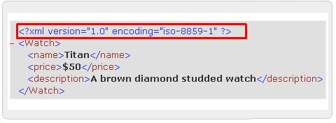
Evolution of XML
HTML | XML
HTML was designed to display data. | XML was designed to carry data.
HTML displays data and focuses on how data looks. | XML describes data and focuses on what data is.
HTML displays information. | XML describes information.

Slide 6
Features of XML
XML stands for Extensible Markup Language
XML is a markup language much like HTML
XML was designed to describe data
XML tags are not predefined
XML uses a Document Type Definition (DTD) or an XML Schema to describe data

Slide 7


Benefits of XML
Data independence - separates the content from its presentation
Easier to parse - absence of formatting instructions makes it easy to parse
Reducing Server Load - semantic and structural information enables it
to be manipulated by any application, can now be performed by clients
Easier to create – can easily create with the most primitive text processing tools
Web Site Content – can be transformed into a number of other formats
Remote Procedure Calls – protocol that allows objects on one computer to call objects on another computer
E-Commerce - can be used as an exchange format

Slide 8
XML Document Structure 1-4
The two sections of an XML document are:
Document Prolog
Root Element
An XML document consists of a set of unambiguously named "entities".
Every document starts with a "root" or document entity. All other entities are optional.
A single entity name can represent a large amount of text. The alias name is used each time some text is referenced and the processor expands the contents of the alias.

Slide 9
XML Document Structure 2-4
Document Prolog
Document prolog contains metadata and consists of two parts - XML Declaration and Document Type Declaration.
XML Declaration specifies the version of XML being used.
Document Type Declaration defines entities’ or attributes’ values
and checks grammar and vocabulary of markup.
Root Element
Also called a document element.
It must contain all the other elements and content in the
document.
An XML element has a start tag and end tag.

Slide 10
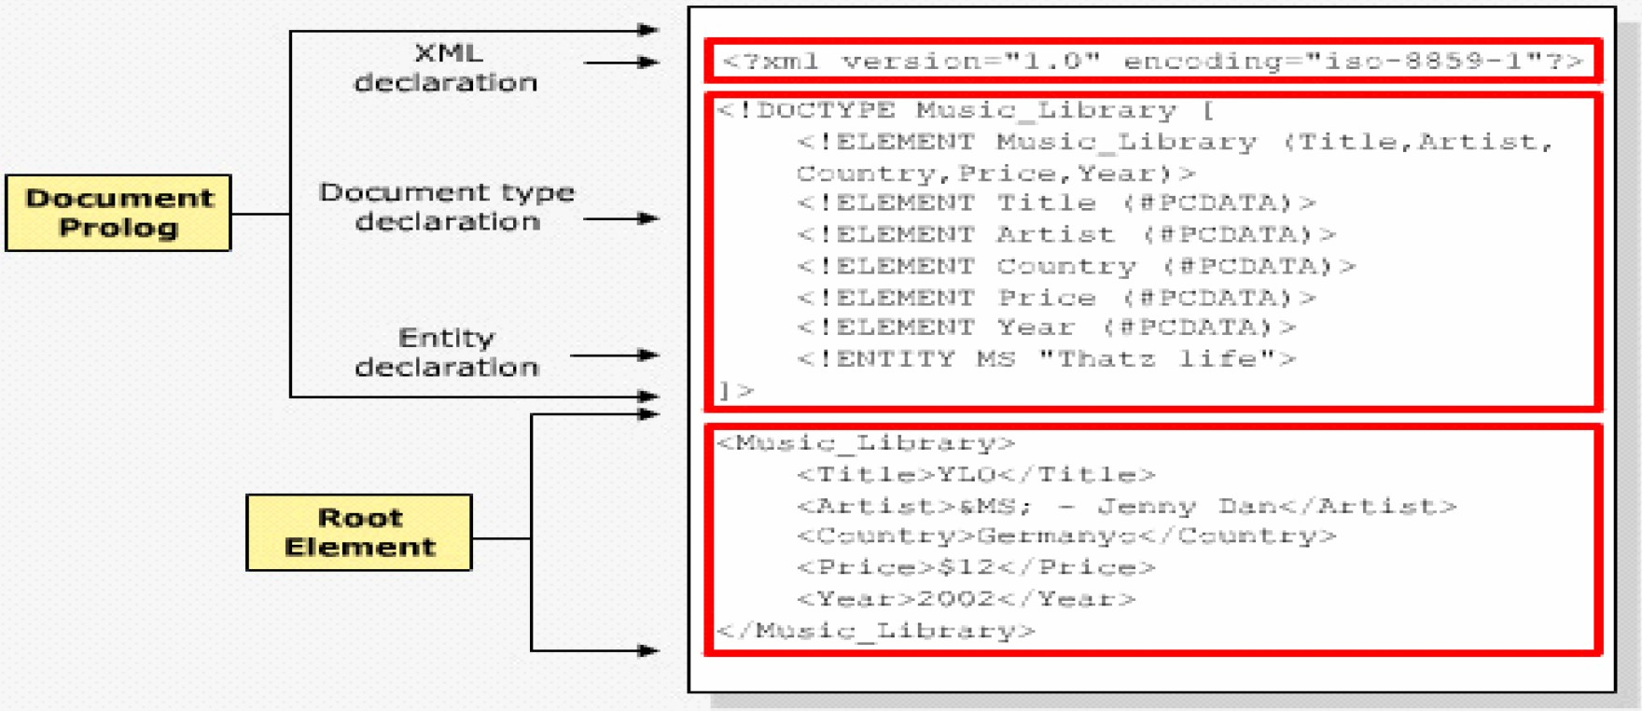
XML Document Structure 3-4

Slide 11

XML Document Structure 4-4
Code Snippet
<?xml version=”1.0” encoding=”iso-8859-1”?>
<!DOCTYPE Music_Library [
<!ELEMENT Music_Library (Title,Artist,Country,Price,Year)>
<!ELEMENT Title (#PCDATA)>
<!ELEMENT Artist (#PCDATA)>
<!ELEMENT Country (#PCDATA)>
<!ELEMENT Price (#PCDATA)>
<!ELEMENT Year (#PCDATA)>
<!ENTITY MS “Thatz life”>
]>
<Music_Library>
<Title>YLO</Title>
<Artist>&MS; - Jenny Dan</Artist>
<Country>Germanyo</Country>
<Price>$12</Price>
<Year>2002</Year>
</Music_Library>
where,
The first block indicates xml declaration and document type declaration. Music_Library is
the root element.

Slide 12

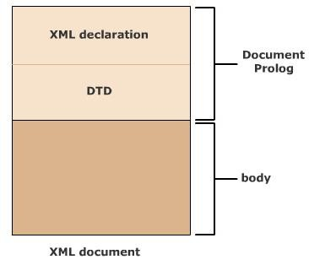
Logical Structure
The logical structure gives information about the elements and the order in which they are to be included in the document.
It shows how a document is constructed rather than what it contains.
Code Snippet
<?xml version=”1.0” encoding=”iso-8859-1” ?>
Code Snippet
<!DOCTYPE
“Mlibrary.dtd”>
Music_Library
SYSTEM

Slide 13
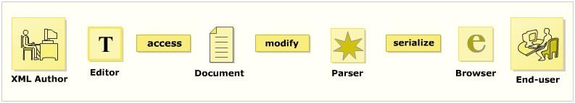
XML Document Life Cycle
XML document creation
Scanning
Parsing
Access
Conversion into Application program
Modification
Serialization

Slide 14
Editors
Main Functions:
Add opening and closing tags to the code
Check for validity of XML
Verify XML against a DTD/Schema
Perform series of transforms over a document
Color the XML syntax
Display the line numbers
Present the content and hide the code
Complete the word
Some popularly used editors are:
XMLwriter
XML Spy
XML Pro
XMLmind
XMetal

Slide 15
Parsers 1-2
An XML parser:
Reads the document
Verifies it for its well-formedness
After verification, converts it into a tree of elements
Commonly used parsers:
Crimson, Xerces, Oracle XML Parser, JAXP, MSXML
Type of parsers:
Non Validating parser
Validating parser

Slide 16
Parsers 2-2
Non Validating parser
It checks the well-formedness of the document.
Reads the document and checks for its conformity with XML standards.
Validating parser
It checks the validity of the document using DTD.
Notes:
Validity: hieu luc

Slide 17
Browsers
Web browsers can format XML data and display it to
the user.
Other programs like database, Musical Instrument Digital Interface (MIDI) program or a spreadsheet program may present XML data accordingly.
Commonly used web browsers:
Netscape, Mozilla, Internet Explorer, Firefox, Opera

Slide 18
Creating an XML document
An XML document has three main components:
Tags(markup) and text(content)
DTD or Schema
Formatting or display specifications
The steps to build an XML document are as follows:
Create an XML document in an editor
Save the XML document
Load the XML document in a browser

Slide 19
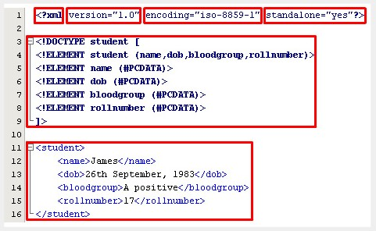
Exploring the XML document 1-2
Characters are encoded using various encoding formats. The character encoding is declared in encoding declaration.
XML declaration tells the version of XML, the type of character encoding being used and the markup declaration used in the XML document.
XML declaration should start with the five character string, <?xml. It indicates that the document is an XML document.

Slide 20
Exploring the XML document 2-2
Indicates the presence of external markup declarations. “Yes” indicates that there are no external markup declarations and “no” indicate that external markup declarations might exist.
Declares and defines the elements used in the document class.
Defines the content of the XML document.

Slide 21

Well-formed XML document
XML tags should be valid
Length of the tags depend on the XML processors
XML attributes should be valid
XML documents should be verified
Minimum of one element is required
XML tags are case sensitive
Every start tag should end with end tag
XML tags should be nested properly

Slide 22
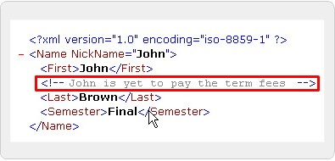
Comments
Used for the people to give information about the code
Usually made for the content

Slide 23


Classification of character data
Character data describes the document’s actual
content with the white space.
The character data can be classified into:
Character Data (CDATA)
Parsed Character Data (PCDATA)

Slide 24
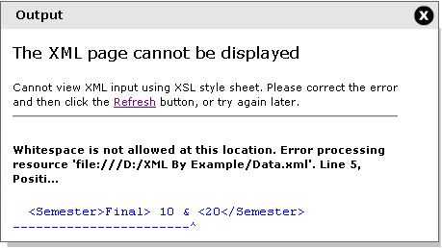
PCDATA
The data that is parsed by the parser is called as PCDATA.
Code Snippet
<Name nickname=’John’>
<First>John</First>
<!--John is yet to pay the term fees-->
<Last>Brown</Last>
<Semester>Final> 10 & <20</Semester>
</Name>

Slide 25
CDATA
Stands for character data that has reserved and white space characters in it.
Is not parsed by the parser, it is commonly used for scripting code.
Syntax
<![CDATA[ data ]]>
Snippet
<Sample>
<![CDATA[
<Document>
<Name>Core XML</Name>
<Company>Aptech</Company>
</Document>]]>
</Sample>

Slide 26
Entities 1-3
XML document is made up of large amount of information
called as entities.
Every entity consists a name and a value.
Entity reference consists of an ampersand (&), the entity
name, and a semicolon (;). Entity Categories: General Entity
These are the entities used within the document content.
They refer to the content of a named entity.
References to these entities: ‘&<entity_name>;’
Parameter Entity
These types of entities are used only in the DTD.
These type of entities are declared in DTD.
References to these entities: ‘%<entity_name>;’

Slide 27

Entities 2-3
Predefined Entity | Description | Output
&lt; | produces the left angle bracket | <
&gt; | produces the right angle bracket | >
&amp; | produces the ampersand | &
&apos; | produces a single quote character | ‘
&quot; | produces a double quote character | “

Slide 28


Entities 3-3
Code Snippet
<?xml version=”1.0”?>
<!DOCTYPE Letter [
<!ENTITY address “15 Downing St Floor 1”>
<!ENTITY city “New York”>
]>
<Letter>
<To>&quot;Tom Smith&quot;</To>
<Address>&address;</Address>
<City>&city;</City>
<Body>
Hi! How are you?
The sum is &gt; $1000
</Body>
<From>ARNOLD</From>
</Letter>

Slide 29

DOCTYPE declarations 1-3
DTD File:
Syntax
<! DOCTYPE name_of_root_element
SYSTEM “URL of the external DTD subset” [ Internal DTD subset
]>
where,
name_of_root_element is the name of the root element
SYSTEM is the url where the DTD is located
[Internal DTD subset] are declarations in the document

Slide 30
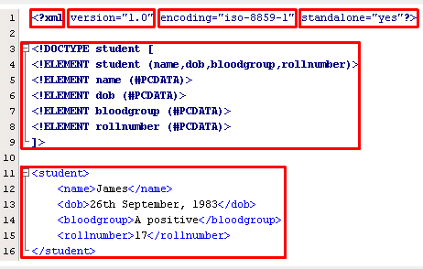
DOCTYPE declarations- Internal 2-3
Code Snippet
Internal

Slide 31

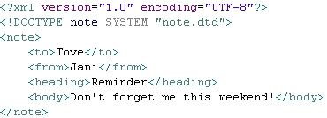
DOCTYPE declarations- External 3-3
DTD file (note.dtd)
XML file

Slide 32
Attributes
Attributes are case sensitive and must start with a
letter or underscore.
Syntax
<elementName attName1=”attValue2” attName2=”attValue2”...>
Code Snippet
<?xml version=”1.0” ?>
<Player Sex=”male”>
<FirstName>Tom</FirstName>
<LastName>Federer</LastName>
</Player>

Slide 33
Summary 1-2
Introduction to XML
XML was developed to overcome the drawbacks of earlier markup languages.
XML consists of set of rules that describe the content to be displayed in the document.
XML markup contains the content in the information
containers called as elements.
Exploring XML
XML is divided into two parts namely, document prolog
and root element.
An XML editor creates the XML document and the parser validates the document.

Slide 34
Summary 2-2
Working with XML
XML document is divided into XML Version Declaration, DTD and the document instance in which the markup defines the content.
The XML markup is again categorized into structural, semantic and stylistic.
The output of the XML document is displayed in the
browser if it is well formed.
XML Syntax
Comments are used in the document to give information
about the line or block of code.
The content in XML document is divided into markup and character data.
The entities in XML are divided into general entities and parameter entities.
A DTD can be declared either internally or externally.

